Slide 1
INTRODUCTION TO QUANTITATIVE METHODS
DR. NATHANIEL OWEN
LANGUAGES AND APPLIED LINGUISTICS
24TH JANUARY 2019

Slide 3
Issues in measurement
What is measurement?
What does it mean to ‘measure’ something?
What kind of things do we measure?
Why do we measure them?

Slide 4
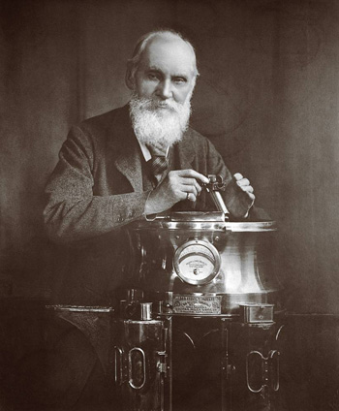
Objective measurement
William Thomson, 1st Baron Kelvin, 1824 – 1907
"In physical science the first essential step in the direction of learning any subject is to find principles of numerical reckoning and practicable methods for measuring some quality connected with it. I often say that when you can measure what you are speaking about, and express it in numbers, you know something about it; but when you cannot measure it, when you cannot express it in numbers, your knowledge is of a meagre and unsatisfactory kind; it may be the beginning of knowledge, but you have scarcely in your thoughts advanced to the state of Science, whatever the matter may be." [PLA, vol. 1, "Electrical Units of Measurement", 1883-05-03]
TASK: Is it true that if we cannot measure something, we cannot know anything about it?
Is an inability to measure something a sign that we cannot define it properly?

Slide 5
Principles of measurement
Reductionism:
an attempt to explain complex phenomena in terms of simpler, underlying causes
Turning a complex, but isolated, language performance into a number indexical of language ability to make claims about proficiency in some real-world language context
E.g. “grammar is far more powerful in terms of generalisability than any other language feature” (Davies, 1978: 151)
However, language is not isolated; it always occurs in social contexts (Wittgenstein, 1951).
TASK: To what extent can we simplify a phenomenon before lose what we are interested in?

Slide 6
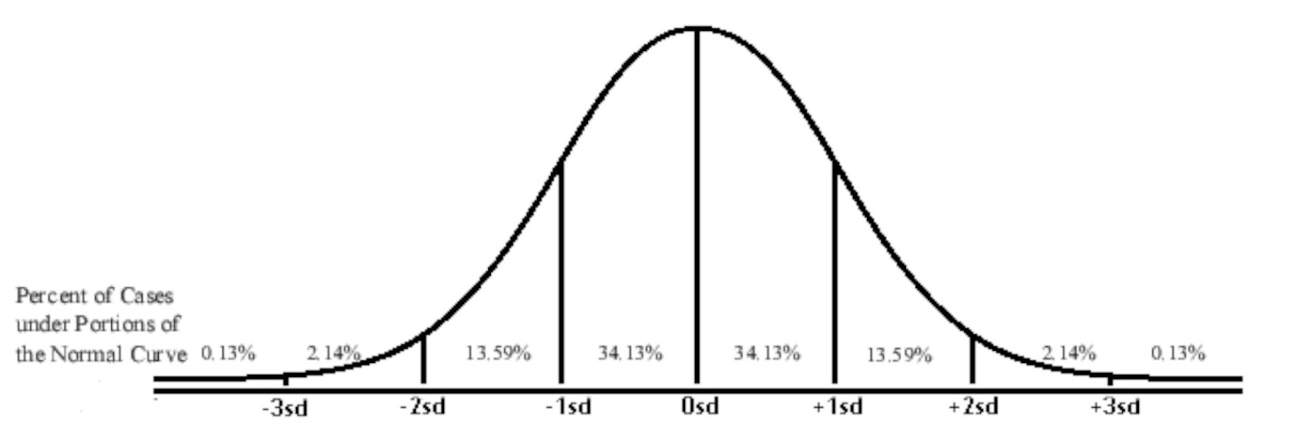
Principles of measurement
Central limit theorem: large numbers of observations will tend towards centrality.
TASK: What phenomena can you think of that fit this pattern?

Slide 7
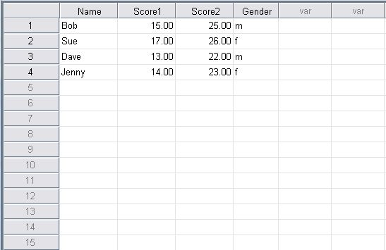
Key Concepts in objective measurement
N-size: the number of observations
Variable: a characteristic or feature or measure collected and placed into a dataset for each observation
NOTE: A statistic is a single number representative of some larger ‘reality’. It is claimed to be an ‘index’ of that reality

Slide 8
Hypotheses
What is a hypothesis?
A reasonable proposal of an explanation for observations or a reasonable proposal of a solution to a problem
What makes a good hypothesis?
Specific and testable
What should it look like?
A directional statement – a clear affirmation, or
It may be a formula: H₁: µ₁ = µ₂
Null hypothesis: H₀: µ₁ ≠ µ₂

Slide 9
Hypotheses - TASK
Consider the following hypotheses. Are they ‘good’ or ‘bad’? Give reasons.
Democratic education improves the learning of young people.
Group work is good for children.
The level of music in affects memory functioning in GCSE revision classes.
What is the best way to teach Chinese students?
Using modern technology in a classroom is beneficial for teenagers.
Boys are more likely to perform well if learning is perceived as competition.
The ability to communicate easily is a mark of the recognition of personal esteem.
Social language development is related to extroversion.
Physical punishment should never be used in disciplinary practice.
Children with stable home backgrounds perform better on standardised tests.
Using video as well as audio leads to increased comprehension in English listening tasks.
Can we add to our list of what makes a good hypothesis based on discussion of these hypotheses?

Slide 10
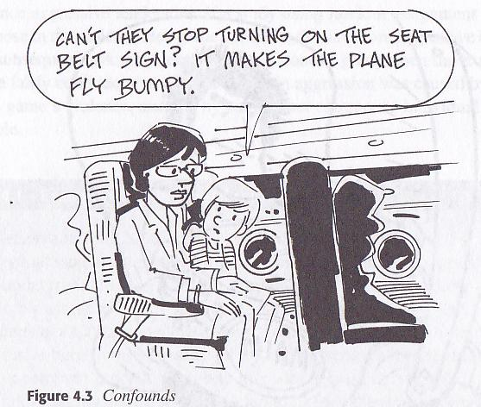
Types of Variables
The dependent variable
Independent variables
Moderator Variables
Control Variables
Intervening Variables

Slide 11
Types of Variables
Dependent variables
What you are measuring as a result of manipulating the independent variable.
Independent variables
What you are changing or manipulating or selecting as the basis for analysis.
Moderator Variables
Variables which affect the strength of relationship between the independent variable and the dependent variable.
Control Variables
Variables which must remain constant throughout the study.
Intervening Variables
Variables that explain the relationship between the observed relationship between the dependent and independent variable. Also called mediating variables.

Slide 12
Types of Variables
The dependent variable
Independent variables
Moderator Variables
Control Variables
Intervening Variables
TASK: Identify relevant variables for the following research question:
“Does revision time
affect English language
test scores?”

Slide 13
Types of Variables
Dependent variables
What you are measuring as a result of manipulating the independent variable. E.g. test scores.
Independent variables
What you are changing or manipulating or selecting as the basis for analysis. E.g. revision time.
Moderator Variables
Variables which affect the strength of relationship between the independent variable and the dependent variable. E.g. gender, age, ethnicity, class.
Control Variables
Variables which must remain constant throughout the study. E.g. length and content of the test.
Intervening Variables
Variables that explain the relationship between the observed relationship between the dependent and independent variable. Also called mediating variables. E.g. revision materials (books, computers etc.); revision strategies.
TASK: How would you quantify these variables?

Slide 14
Types of Scales
Nominal
Ordinal
Interval
Ratio

Slide 15
Types of Scales
Categorical
Nominal
Categorical data (unordered). E.g. nationality; gender. Can be any number of categories per variable (e.g. only two genders per class (male/female) but there may be 4, 5, 6 etc. nationalities).
N.B. Nominal data with only two categories e.g. gender is often termed ‘dichotomous data’. Responses to individual test or questionnaire items are often dichotomous (e.g. correct/incorrect; yes/no).
Ordinal
Two or more categories (like nominal data) but these may be ranked. E.g. Likert item responses:
5 = Agree a lot
4 = Agree to some extent
3 = Not sure
2 = Disagree to some extent
1 = Disagree a lot.
These may be ranked from most to least positive or vice versa.

Slide 16
Types of Scales
Continuous
Interval
Measurement in which different statistics are assigned numerical value.
‘Continuous’ as data points may be ordered on a scale in which values are equidistant. E.g. temperature, BUT we cannot say that ‘40 degrees is twice as hot as 20 degrees’ (because zero degrees is not a ‘start point’ of temperature).
BUT zero has no significance in interval data. E.g. temperature: ‘Zero degrees celsius’ does not mean that there is no temperature.
Ratio
Similar to interval data: the principal difference is that zero indicates that there is none of that variable. E.g. height, mass, distance.
Kelvins would be ratio data, as zero Kelvins (absolute zero) tells us that there is no temperature.
Is called ‘ratio data’ as there is a standard of comparison between values
e.g. 10 kilometres is twice as far as 5 kilometres.

Slide 17
Potential Problems
Grouping Issues
Self-selection
Mortality
Maturation
People Issues
Hawthorne effect
Halo effect
Expectancy of participants and researchers
Measurement Issues
Practice effects
Reactivity effects (the instruments cause a change, particularly in questionnaire research)
Reliability (consistency)
Validity and Generalizability

Slide 18
Constructs
What is a construct?
A construct is an abstract notion or principle that you believe exists. It is difficult to define, not visible or not directly observable.
Example of a construct: motivation
Hypothesis: ‘more motivated workers are more productive workers’.
Compare ‘motivated’ with ‘productive’.
We can measure productivity (in terms of output (total or per worker) but how do we measure ‘motivation’?

Slide 19
Surveys and Questionnaires
Behaviour
Opinions/values
Feelings (likes/dislikes)
Sensory Questions (environment, sounds, light, space...)
Problems/Solutions
Priorities
Attitudes

Slide 20
Question Types
TASK:
What are the advantages/disadvantages of
Open Response questionnaires?
Closed Response questionnaires?

Slide 21
Question Types
Open Response
Wide range of answers
Exploratory, but
Difficult to code
Difficult to analyze
Difficult to investigate reliability/validity
Closed Response
Easy to code
Easy to analyze
Easy to interpret
Easy to investigate reliability, but
Difficult to write
Not exploratory

Slide 22
Questionnaire Guidelines
Question length
Question clarity
Negative questions
“Studying German is a difficult subject”
(Strongly agree, agree, unsure, disagree, strongly disagree)
Double-barrelled questions
Language learners should spent more time on grammar and less time on studying word lists.
Loaded words
English is clearly the first choice of a second language in a global economy
(Strongly agree, agree, unsure, disagree, strongly disagree)
Leading questions
Your teacher has decided to give two-weekly tests. Do you agree?
Embarrassing questions
Which of the following languages do you think is useless in the modern world?
Biased questions
Men make terrible language teachers.
(Strongly agree, agree, unsure, disagree, strongly disagree)

Slide 23
Common Statistical Analysis
Normal Distribution
Sample Size: http://www.surveysystem.com/sscalc.htm
Descriptive Statistics
Mean, Median, Mode
Standard Deviation, Range

Slide 24
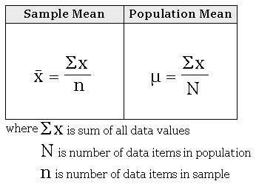
Common Statistical Analysis
Normal distribution:
The greater the number of observations, the greater the chance of the distribution approaching normality. E.g. height, weight, test scores.
The fewer the number of observations, the greater the impact of outliers on our results.
Mean, median and mode are all the same in a normal distribution.
Mean
the sum of all data values divided by
total number of data items.
Median
It is the central data item in the entire
ordered or sorted data set.
Mode
the data value that is found or
repeated most often in the data set. A data set possessing two modes is called ‘bimodal’.

Slide 25
Standard deviation and range
Range
The range is the difference between the smallest and the largest observation. It gives a weak indication of the spread of data.
the interquartile range is a more robust measure of statistical dispersion, being equal to the difference between the upper and lower quartiles (in which the data set is ordered and divided into four).
The corresponding measure of central tendency is the median.
Standard deviation
shows how much variation or dispersion exists from the mean.
Tells us how effective the mean is as a measure
of central tendency.
Subtract the mean from each value, square the
resulting figures and add them together. Divide
by the number of observations minus 1, then take the square root of this figure to get the standard deviation of the sample population.

Slide 26
Correlation
A measure of the strength of the linear relationship between two variables.
The Pearson correlation coefficient (r) can take a range of values from +1 to -1
The two variables have to be measured on either an interval or ratio scale.
However, the two variables can be measured on different scales.
Correlation treats all variables
equally. Therefore, you can
compare independent and
dependent variables.
The correlation coefficient makes
no account of any theory behind
why you chose the two variables
to compare.
BE CAREFUL. Correlation is not causation. A relationship does not mean that the variables are related. E.g. you could establish a strong correlation between shoe sizes and reading fluency. But they are not related!
 | Coefficient, r
Strength of Association | Positive | Negative
Small | .1 to .3 | -0.1 to -0.3
Medium | .3 to .5 | -0.3 to -0.5
Large | .5 to 1.0 | -0.5 to -1.0

Slide 27
T-test (independent/dependent)
Determines whether there is a statistically significant difference between the means in two unrelated groups (independent t-test) or related groups (dependent t-test).
Independent t-test:
investigating differences in individuals, which means that when comparing two groups, an individual in one group cannot also be a member of the other group and vice versa.
The independent t-test requires that the dependent variable is approximately normally distributed within each group.
Dependent t-test:
“Repeated-measures" statistical test. This indicates that the same subjects are tested more than once. The dependent t-test can also look for "changes" between means when the subjects are measured on the same dependent variable but at two time points.
For the dependent t-test, the distribution of the differences between the scores of the two related groups needs to be normally distributed.

Slide 28
Research Questions - TASK
Clearly and explicitly define your problem
Think about your research questions: can/should they be answered quantitatively? If so, what variables can you make explicit?
The research questions should express a relationship between the variables of interest.
The statement of relations between variables must allow the possibility of empirical measurement (think about how).
Research questions (and hypotheses for that matter) do not transmit value judgments.

Slide 29
THANK YOU

