Slide 1
The ‘seven challenges’
Aims
Consider seven common challenges faced by panel members:
Focus on witnesses who may have been harmed by a registrant
  Have vulnerabilities affecting participation and evidence quality
  To reduce the risk of re-traumatisation when recounting traumatic events
Recognise that vulnerability is situational and may change over time (Sorbie & Garippa, 2025)
The overall aim is to prompt reflection around preparation, questioning, emotional responses, and the overall witness experience and to help panel members think more deeply about their role in reducing harm and supporting witnesses effectively.
Approach / context
Present realistic scenarios
Explore how challenges can be addressed using a trauma-informed approach
Ensure fairness to all parties is maintained
Scenarios are designed for learning and reflection
Not intended to reflect or critique any specific regulator’s processes

Slide 2
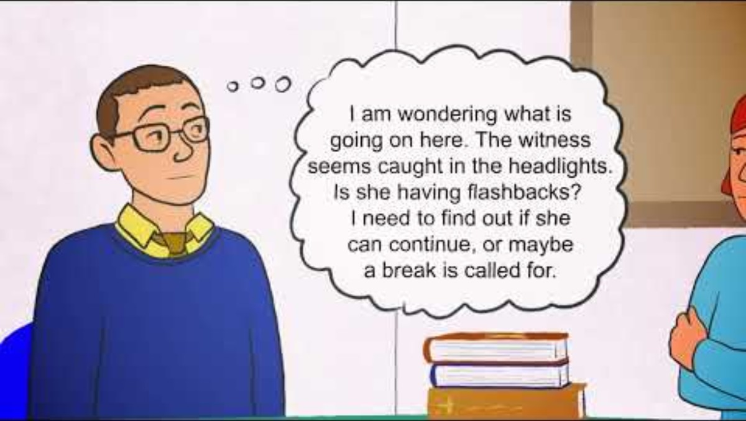
The seven challenges

Slide 3
We value your feedback
We are always looking for ways to improve our training.
Please provide feedback using the links below:
Feedback survey for those being trained is here
Feedback for trainers is here
For further information or feedback on the training please contact:
Dr Gemma Ryan-Blackwell, The Open University, gemma.ryan-Blackwell@open.ac.uk
Emerita Professor Louise Wallace, The Open University, louise.Wallace@open.ac.uk

