Slide 1


Postgraduate Research Studies
Faculty of Wellbeing, Education and Language Studies

Slide 2

Faculty of Wellbeing, Education and Language Studies

Slide 3
Postgraduate research core team
Associate Dean, Research
Director of Postgraduate Research Studies, WELS
EdD Programme Leader
DHSC Programme Leader WELS PGR Convenors

Slide 4
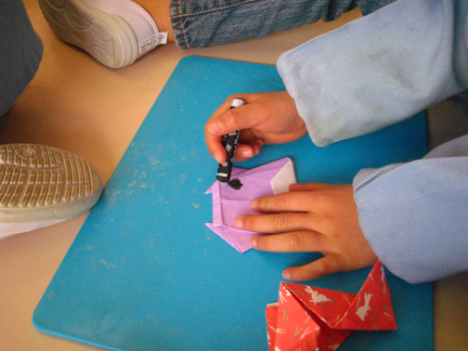
WELS research themes
Children and families
Education and learning
Educational technology
Global development
Health and wellbeing
Languages and literacies
Social care
For more information please visit: http://wels.open.ac.uk/research

Slide 5
Research degree programmes

Slide 6
Overview of OU doctorates
PhD | Professional Doctorates (EdD/DHSC)
Level 8 at time of thesis | Level 8 at first assignment
No cohort | Cohort
Individual schedule from Yr 1 | Individual schedule from Yr 3
1150 University of Paris | 1921 Harvard (1997 OU)
A career pathway into HE | Career development in practice
Full-time or part-time | Part-time
Original contribution to disciplinary knowledge | Original knowledge contribution to professional practice/policy
Thesis: 100,000 | Thesis: 65,000 words

Slide 7
Funding routes
PhD | Professional Doctorates and Distance PhD
ESRC Doctoral Training Partnership (GUDTP) Health and Wellbeing Pathway Innovation in Learning Pathway | n/a
AHRC Doctoral Landscape Award | n/a
Faculty studentships (Include research support grant) | n/a
Self-funded route
Staff fee waiver

Slide 8
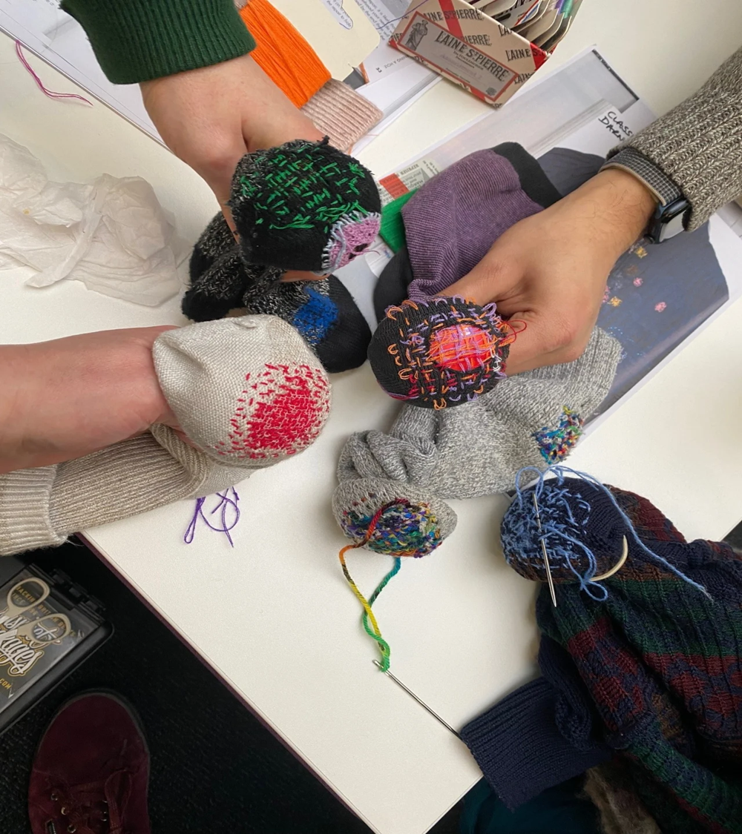
PhDs: Key information
Contribution to research/knowledge
On campus: based in Milton Keynes, UK
Study from home with a distance PhD
2+ supervisors
For more information go to:
PhD programme | Faculty of Wellbeing, Education and Language Studies (open.ac.uk)

Slide 9

PhD: Upgrade assessment
Summative assessment
At the end of year 1 (full-time) or year 2 (part-time)
Assessed by two independent assessors
Elements
  Project report (with viable research question, critical literature review situating the proposed research, research proposal, work plan)
  Upgrade viva
  Summary of your skills audit/training needs analysis
  Evidence of a presentation research at a public or semi-public event

Slide 10

PhDs: study journey (full-time)
Year 1 | Year 2 | Year 3 | Year 4
Reviewing the literature & developing research questions | Fieldwork | Continuation of literature review | Viva voce examination
Pilot study (?) | Data collection | Analysis | Corrections
Training | Data analysis | Dissemination | Dissemination
Skills audit and development | Continuation of literature review | Writing up | Completion and graduation
Upgrade assessment | Writing up methodology | Revision of full drafts
Ethical approvals | Dissemination/ conference attendance | Submission of thesis

Slide 11

Professional Doctorates: Degrees
Contribution to research that informs practice and/or policy
Doctorate in Education (EdD)
Doctorate in Health and Social Care (DHSC)

Slide 12
Professional Doctorates: Target students
EdD | DHSC
professionals in education (including head teachers and trainers) | health and social care professionals (including registered nurses, social workers, therapists, managers)
other professionals working in formal and non-formal settings (including the public, voluntary and private sectors) | other professionals working across health and social care (including the public, voluntary and private sectors)
people working in informal educational settings (e.g. private tutors) | Experts by experience, carers. Also volunteers and advocates (if they work in health and social care)

Slide 13
Professional Doctorates: Structure of the programme
​
Registration period:
4 academic calendar years minimum completion period
8 academic calendar years maximum completion period
Two stage programme:
Stage 1 – taught element (2 years)
Stage 2 – research element (2-6 years)
Blended teaching strategy
Distance/Online learning: Online modules in research skills
Asynchornous and live seminars
Supervision
Face to face teaching at residential weekends: Lectures
Seminars
Supervision

Slide 14

Stage 1: year 1
Modules
Research skills
Literature reviewing
General preparation for research in professional practice
Target
Identification of research literature and contribution to the research field.
Assessment
Two formative assignments (5,000 words)
Summative assignment (10,000 word literature review)

Slide 15
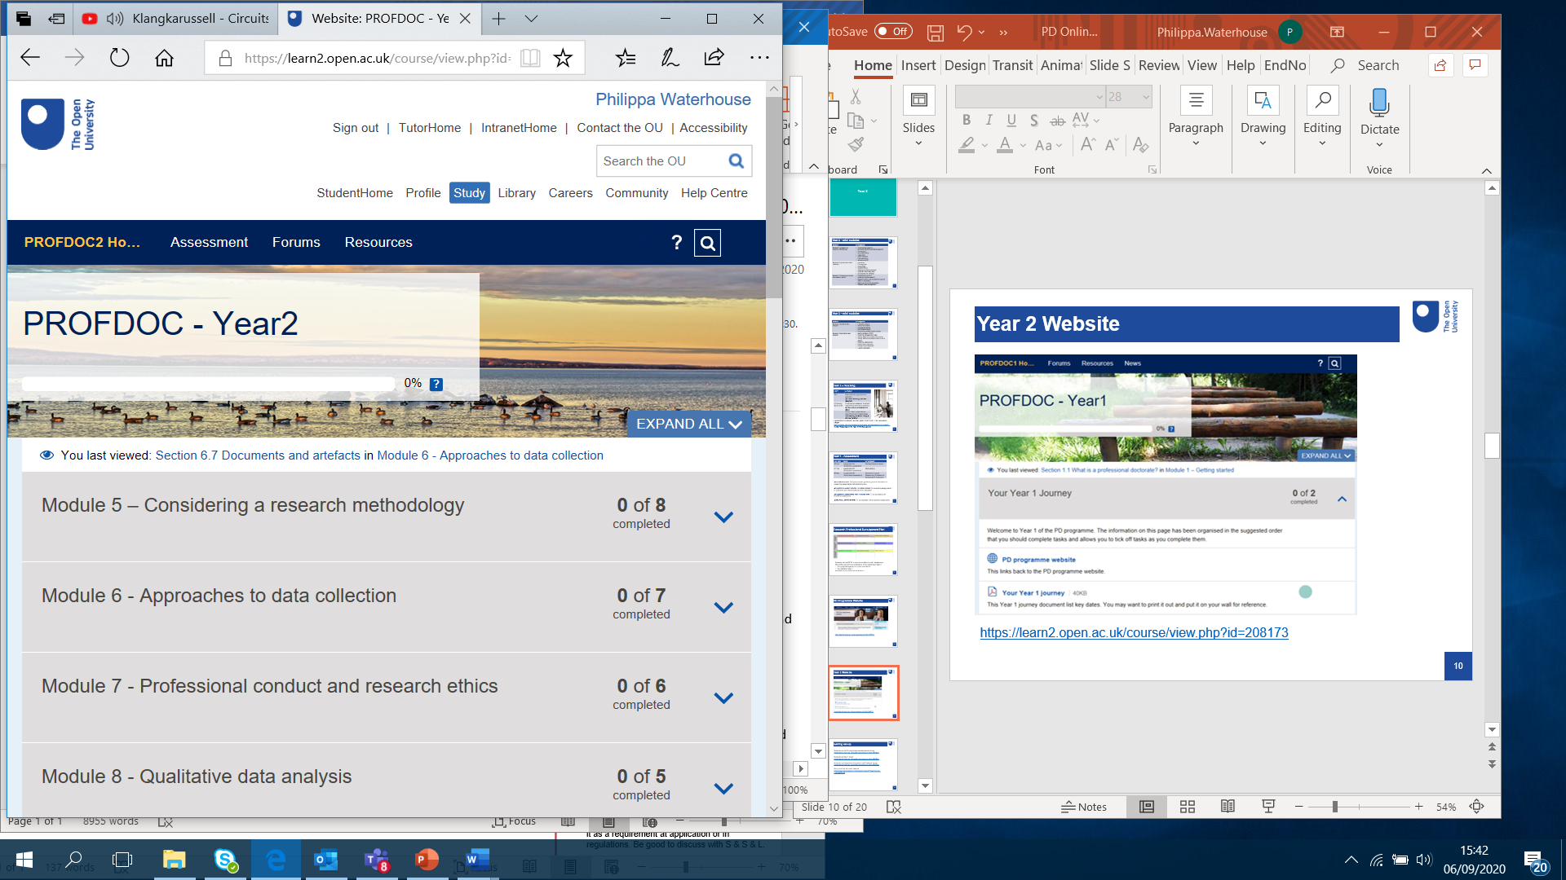
Stage 1: year 2
Modules
Methodology and approaches to data collection
Ethics
Target
Refinement of research questions, research proposal, contribution to the field and impact on professional practice.
Assessment
Two formative assignments (5,000 words)
One summative assignment (15,000 word research proposal)

Slide 16

Stage 2: year 3-8
Focus
Individual research project supervised by specialists in the field
Continued skills development
Target
Development of guided research project.
Assessment
Assignments 7-9 (formative assignment, 5,000 -15,000 words).
Assignments 10-12 (formative assignment, 30,000-65,000 words).
Thesis (summative assignment, 65,000 words).

Slide 17
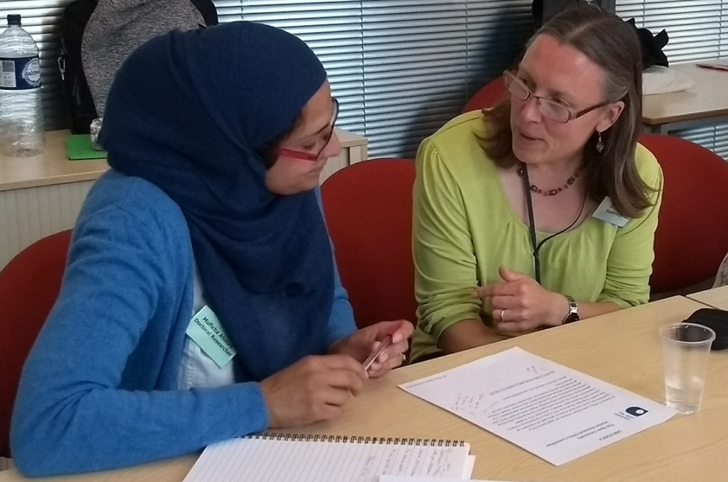
Supervision
A supervisory team in place from the start
For more information go to: Professional doctorate programmes | Faculty of Wellbeing, Education and Language Studies (open.ac.uk)

Slide 18
Applications

Slide 19

Entry requirements: PhD
1 | Fit in one of the research areas of WELS
2 | Masters Degree in a related discipline from a UK/EU university or another recognised degree-awarding body
3 | Two independent references (one academic reference and one reference from practice)
4 | Good written and spoken communication in English
5 | IELTS for international applicants whose language of instruction wasn’t English

Slide 20

Entry requirements: EdD/DHSC
1 | Fit in one of the programme areas of the EdD/DHSC
2 | Masters Degree in Education or in Health/Social Care, or a related discipline from a UK/EU university or another recognised degree-awarding body
3 | At least two years of relevant professional experience
4 | Two independent references (one academic reference and one reference from practice)
5 | Good written and spoken communication in English
6 | IELTS for international applicants whose language of instruction wasn’t English
For the DSHC, applicants can include unpaid and family carers, ‘Experts by experience’, advocates and ‘expert patients’ but the application must carefully describe their field of practice and what access requirements would be required.

Slide 21
Proposal submission
Complete and submit
  Application form
  Research proposal form (read the guidance before completing the form)
  WELS information: Research degrees | Faculty of Wellbeing, Education and Language Studies (open.ac.uk)
  OU prospectus: Research Degrees | PhD | EdD | DHSC | MPhil | The Open University

Slide 22

Timeline: Application period
  Applications usually open in November and deadline for submission is usually early in the new year. Please note however that deadlines may differ, depending on the programme or funding scheme. Please refer to published details on relevant websites, or contact research-degrees-WELS@open.ac.uk
  It is useful to plan in advance!

Slide 23
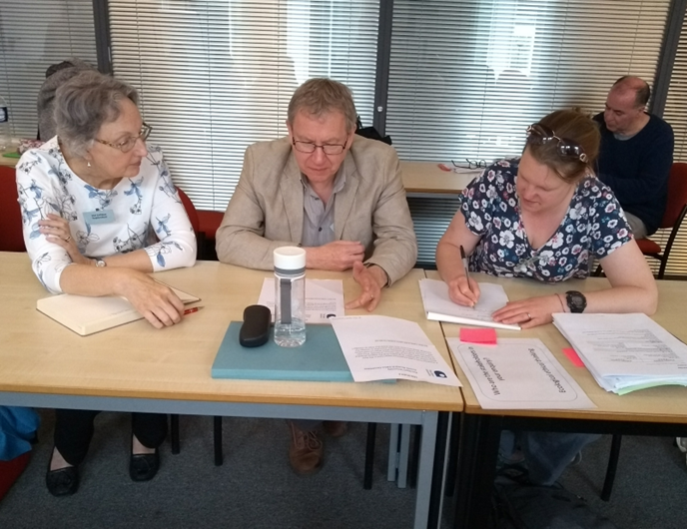
Timeline: Selection process
February/March
Longlisting and shortlisting
Supervisor expertise and availability
Entry criteria met?
Quality of proposal?
March/April
Interviews
May/June
Applicants’ nominations
>>> July: offer letters sent out

Slide 24
Selection criteria
  Fit with key research themes and targeted projects
  Academic background
  Entry level subject knowledge
  Critical analytic skills
  Writing skills
  Verbal communication skills
  Feasibility of the research proposal
  Awareness of research process and what’s involved in a doctorate

Slide 25
Resources

Slide 26

Open resources
Interactive resource with guidance on writing a doctoral proposal and preparing for the interview Writing your research proposal - OpenLearn - Open University
Professional Doctorate hub: Professional Doctorate Hub - OpenLearn - Open University
WELS PGR Bloggers: https://www.open.ac.uk/blogs/welspgr/
Applying to carry out doctoral research: some practical tips- Blog post

Slide 27
All enquiries:
research-degrees-WELS@open.ac.uk

