Slide 1
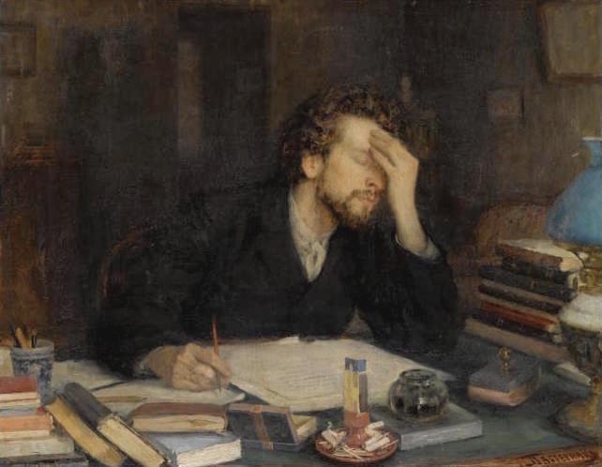
Dealing with writer’s block
Jackie Tuck
jackie.tuck@open.ac.uk

Slide 2
Aims of the session
Debunk some myths about (research) writing which (when debunked) might help us deal with “writer’s block”.
Explore what writer’s block might mean in practice for you.
Think about/try out some strategies for moving past stumbling blocks and sticking points.

Slide 3
Writer’s Block – unhelpful metaphors?

Slide 4
Myth #1
Writing is “writing down” or “writing up”.

Slide 5
Myth #2
Writing is straightforward.

Slide 6
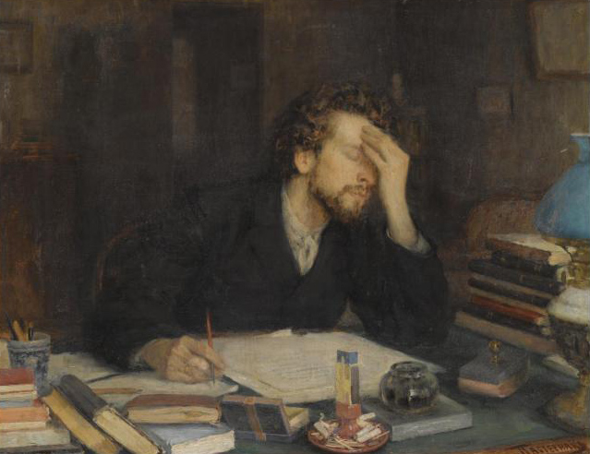
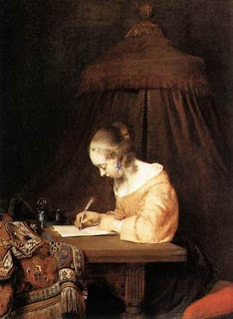
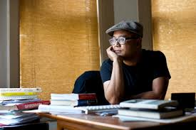
Myth #3
Writing is primarily an individual activity

Slide 7
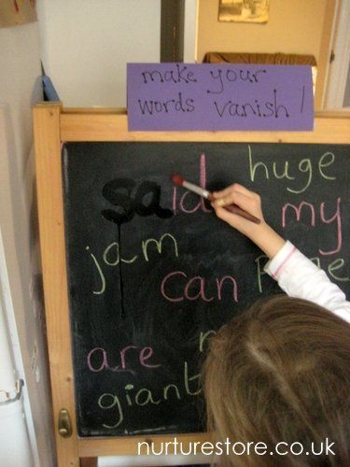
Myth #4
Writing is something we should have mastered at school.

Slide 8
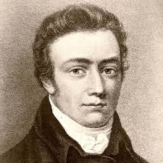
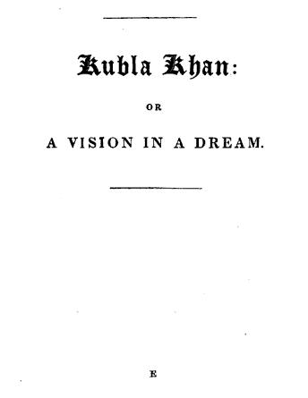
Myth #5
Writing is the product of inspiration.

Slide 9
“Writing isn’t a purely imaginative activity. It’s highly strategic from the start to the end.”

Slide 10
Myth #6
Writing is perfectable.
« Par une belle matinée du mois de mai, une élégante amazone parcourait, sur une superbe noire somptueuse jument alezane, les allées fleuries pleines de fleurs du Bois de Boulogne. »
The words of Joseph Grand in La Peste by Albert Camus

Slide 11
Probably not a myth
Writing is “high stakes” for students, researchers and academics.
It involves intellectual commitment and risk
It is used as a measure of our success
The rules of the game are not always clear or universally shared…
The risks can be positive but also negative.

Slide 12
So…is it ‘writer’s block’?
Writing is sometimes hard and for good reasons.
When we’re not churning out text it doesn’t necessarily mean we are not being productive as writers
It’s possible to start to write without knowing how it will or should turn out
It makes sense to recruit the community you are writing for to help you in various ways
If writing feels difficult, it doesn’t necessarily mean there is something wrong with you.

Slide 13
Discussion: What does writer’s block feel like?
On your own, spend 5 mins jotting down some ways of finishing the following sentence “I feel stuck with my writing when…”
For example,
“I feel stuck with my writing when I don’t know where to start…” or “when the ideas come too quickly and I can’t get them down on paper…” etc.
Then, discuss your experiences with others in your small group. Are some of the situations more serious/problematic than others? If so, why?

Slide 14
Feeling blocked…
I don’t know how to begin
I am afraid to start
I thought I knew what I wanted to say but now I’m not sure
I lose the sense of direction and can’t work out what to say next
I feel that what I am writing is trivial and of no interest to others
I get distracted by other ideas on my mind
I keep writing the same paragraph over and over again
I lose interest in what I am writing
My ideas start jumping around all over the place
I have other pressures which provide easier pay-offs

Slide 15
Discussion: What causes writer’s block for you?
On your own, spend 5 mins jotting down some of the things which tend to cause you to get or feel “blocked” with your writing.
Then share your thoughts with others in your small group.

Slide 16
What’s causing the problem?
Negative feedback from others Not really understanding the expectations Tiredness Anxiety Lack of confidence in the end product Outside distractions (physical, emotional, mental) Muddled thinking | Perfectionism Fear of failure Feeling as though I’m heading up a dead end Procrastination – putting off decisions Trying to live up to high standards Wondering what the point of it all is An inability to impose structure

Slide 17
Discussion: How do you respond to writer’s block?
Discuss in your small group how you respond to the experience and causes of writer’s block. As a group make a note of the solutions and responses you have found helpful.

Slide 18
Some positive responses
Switch activity
Have a break/holiday
Talk to someone else/others
Read my work off screen
Persevere
Move to a new location (to write in)
Read something for inspiration
Do another type of writing

Slide 19
More ideas…
How to Cure Writer’s Block with 101 proven strategies. Get rid of writer’s block today!
William Little 5th September 2017
http://www.stopprocrastinatingapp.com/writers-block
Accessed Saturday 7th October 2017
Wikipedia: “The research discovered a range of solutions from altering the time of day to write and setting deadlines to lowering expectations and using mindfulness meditation.”

Slide 20
Strategies to try
Free writing
Writing to prompts
Snack writing
Social writing – set up peer feedback
Write about writing (or about not writing)
Talk to yourself/talk to others
Target setting
Re-genre
Start in the middle or at the end
Keeping a thread going

Slide 21
Free writing
Good for generating text – getting something down on paper
Good for acquiring a writing habit
Can enable thinking, reflection, feelings
Can increase confidence and optimism
Many different purposes
Writing without stopping
In sentences but no “correcting”, crossing out
For yourself only
Not for everyone – but worth a try!

Slide 22
Free writing topics
Free writing topics can be anything you like. If you are feeling blocked it is helpful if it relates to the writing task which lies ahead without actually being the task. For example:
Write for five minutes on one of the following:
How do I feel about writing the probationary report/this chapter?
Why I am/am not ready to write my probationary report/this chapter…
What do I really think about [particular body of work/topic of my research]?

Slide 23
Writing to prompts
Free write to the prompt
Based on your free writing, generate headings
Oral rehearsal/ discussion
Write under one heading
Choose an appropriate prompt
Review prompts

Slide 24
Examples of prompts
What is my purpose in this chapter?
My aim in writing this chapter is to convince … that…
My main aim is to show…
Why am I starting with this chapter?
I am starting to write chapter X because…
My chapter will cover….
My chapter will not cover…
This chapter will fit in to the larger report by…

Slide 25
Distil
Write for five minutes about the topic your notes cover/the topic of your chapter or section:
Without stopping
In sentences
Without looking at your notes
Trust your brain to do the remembering and synthesizing
Focus on the story and the big picture

Slide 26
Outline
Take five minutes to generate some headings for your chapter or section.
No need for sentences.
Think about the order you want the headings to go in (but may not be fixed…).

Slide 27
Oral rehearsal/discussion
Choose one heading, or several headings, and talk through the point you want to make.
You can do this on your own, even better with a partner.
It is helpful if the partner just listens, but asks for clarification/reformulates to make sure they have understood, rather than supplying their own opinion.

Slide 28
So am I right in thinking that you are trying to argue that…?
If I’ve understood correctly, you are saying that…
Yes, that’s exactly it…
Well, that’s not quite it…

Slide 29
Write under one heading or section of your outline
Write for 15 minutes, in sentences.
Again you could try doing this without looking at notes at the same time as you are actually writing.
Remember “your story should shape your use of your notes, not vice versa” (Murray, 2012, p. 155)
Don’t worry about “polishing” at this stage, but about trying to get down your meaning.
Make a note of key sources you want to draw on/quotations you might want to use (add others later…) even if these are not fully integrated into your text yet.

Slide 30
Review prompts
What answers are emerging in response to the prompts you set out with?
Are any themes emerging?
Anything new or particularly interesting?
Anything which feels like a dead end?
Anything where you feel you need to do more reading?

Slide 31
References
Acocella, J. (2014) ‘Blocked: Why do writers stop writing?’ The New Yorker [online] 14th June. Available at: https://www-nexis-com.libezproxy.open.ac.uk/search/newssubmitForm.do
Clark, R. and Ivanič, R. 1991. The Politics of Writing. London: Routledge
Rose, M. (1985). When a writer can’t write: studies in writer’s block and other composing process problems. London/New York: Guilford Press
Safford David H. (n.d.) ‘Writer’s Block is a Lie and its Ruining your Writing’ at http://thewritepractice.com/writers-block-lie/ Accessed Saturday 7th October 2017

