Slide 1
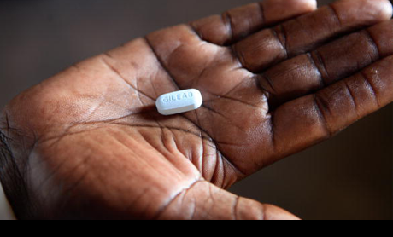
Biomedical HIV prevention: exploring the role of intimate engagements and ways of living through qualitative data re-use.
Dr Peter Keogh, The Open University, UK
Dr Catherine Dodds, University of Glasgow, UK
Notes:
In this second talk, I will present some of the emerging results of the study I talked about methodologically in the session before the break.
The reason we have become involved in qualitative data re-use is because our work spans a period of remarkable change in the HIV epidemic. It starts before there were effective treatments available and goes through the introduction of treatments in 1996, all the way through to the use of HIV treatments for prevention of HIV in previous years. We wanted to re-use our own data to gain insights into the remarkable changes wrought by antiretroviral treatments since 1996.
We do so within the context of claims that we can end AIDS by 2030 [often repeated but also contested]. So the research questions that brought us to this work relates to the meanings and impacts generated by the continuous re-purposing of HIV treatments over the past two decades, and what this might continue to look like in terms of the futures that these treatments are constructing.

Slide 2
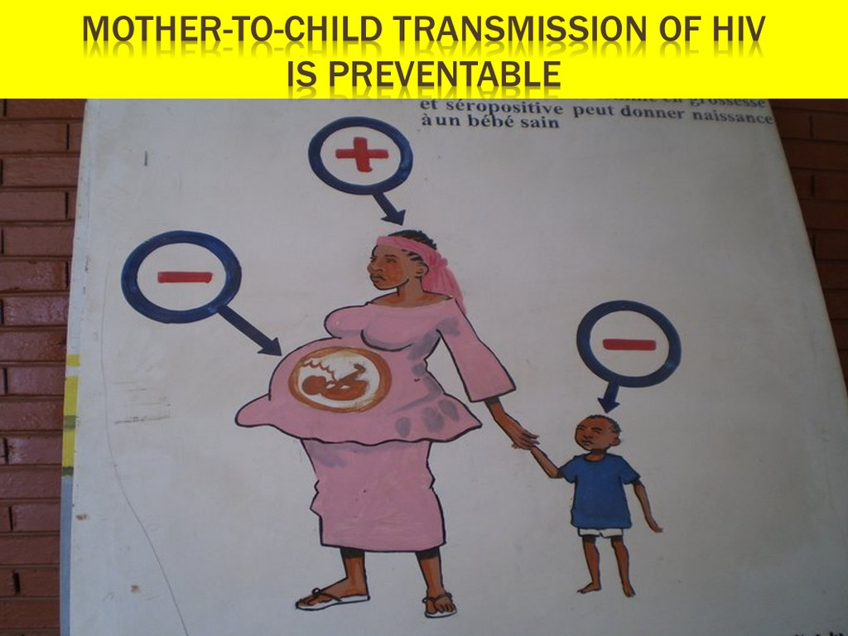
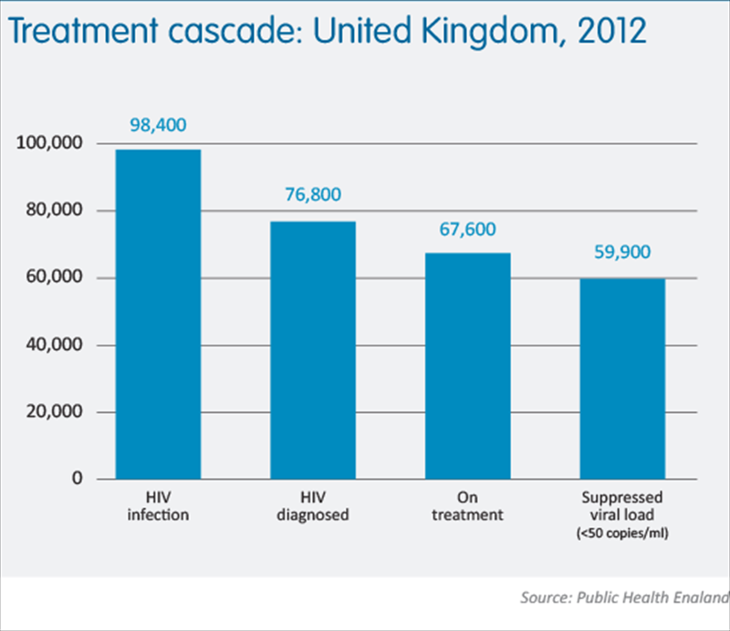
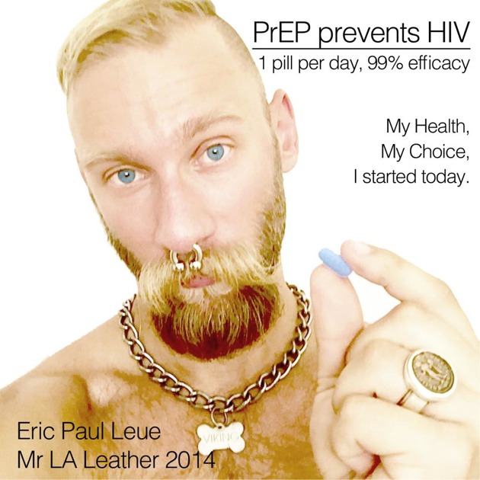
Adaptive biomedical- pharmaceutical HIV prevention technologies
HIV Anti-
retrovirals –
ARVs (1996)
Preventing Mother to child Transmission (~2000)
PEP (~2005)
Treatment as prevention (~2012)
PrEP (2012-)
U=U (2017)
Notes:
RE-WRITE THIS SECTION
This represents some key developments in 20 years of ARV adaptation since 1996.
You might already be aware that prior to 1996, there were not really any effective treatments to support people with HIV (the virus that can lead to AIDS). There were some medications that treated the illnesses that HIV caused, but until that point nothing that had successfully tackled the HIV virus itself, to stop it from replicating in the body and effectively shutting down the immune system.
That all changed in 1996, and at that time, rather than being ‘a single pill taken once a day’ as is shown here – the combination of treatments that made up HIV anti-retroviral therapies usually required a complex combination of very large pills and sometimes liquid medications that needed refrigeration – taken at a range of times of day, and the potential side effects of these various treatments ranged from severe kidney and liver damage, to highly disturbed sleep, hallucinations, changes in fat deposits on the body and strong tingling sensations in the extremities caused by nerve damage.
So these were not simple medications to take, and they were not straightforward to live with, but they offered hope. They offered something other than the certain death that AIDs meant up until that point – and in the HIV field, these treatments changed everything.
**go through each one**
ARV introduction
**shift toward prevention**
PMTCT; PEP; TasP; PrEP
In the past 20 years we have seen a remarkable shift in the way that the HIV epidemic is lived, and what it means, all because of ARVs. But this is not a neutral, nor a global trajectory, the temporal flow shown here for the UK has not been the same in all places. After each of these technologies is launched and brought into its own country’s policy and delivery mechanisms, they each continue to change - in the actual make up of the constituent medications, and also in the ways that they are prescribed to, taken and perceived by users.
Conceptually, as HIV social scientists, we note that each new ARV adaptation combines together with all HIV technologies to help form a discursive context where we might imagine a future where HIV is controlled. Following Mike Michael, to some extent we can imagine this as potential futures that stack up and replace one another, as the newest future subsumes its predecessor. Though at the same time, we need to be aware that each stacked future is produced through the construction of a set of expectations – and each of these successive waves of expectation never turn out quite as the hype would have us believe. The field of the sociology of expectations urges us to attend closely to these cycles of hype and disappointment – that way we can better understand how ARVs are actually constituted in the lives of those who are expected to use them.
So, we set out to ask of our historic datasets, what role do these imagined futures and expectations play in the lived experiences and daily practices of people who are expected to take ARVs (whether for the purposes of treatment, or prevention, or both).
We are examining how lived experience alongside HIV anti-retroviral medications (ARVs) has changed over time; the extent to which identities have been shaped by the increasing biomedicalisation of HIV; and the extent to which social and structural inequalities have impacted on or been reinforced by these developments.
This work will consolidate knowledge, making full use of existing datasets and will lead to future research collaborations.
Given the mixed outcomes of ARVs as treatment, it is vital that the assumptions of the new era of prevention possibilities are interrogated.
The funded work will result in: deposit available datasets to the UK Data Archive; alongside other academic outputs and dissemination, and has also led on to a large bid for a Collaborative Award that we are submitting at the end of this week to the Wellcome.
This work will help develop a social science research agenda that is fully engaged with this changing HIV landscape, positioning social scientists again as critical friends supporting decision-makers and implementers.

Slide 3
Year | Study | Event/era
1997-2000 | Impact of combination therapies Proceeding with care Managing uncertainty | HIV Treatments 1: Early
2001-2004 | Outsider status | HIV Treatments 2: Middle (pre-PEP)
2005-2007 | Proximity to HIV Housing need and HIV in Nottingham PEP talk | HIV Treatments 3: Middle (post PEP)
2008-2009 | Relative safety II | HIV Prevention 1: Nascent (Swiss Statement)
2010-2013 | Plus one HIV support (Wave 5) HIV & the biomedical Keeping confidence | HIV prevention 2: Evolving
Notes:
Here are the primary data sources or datasets we have been working from. I’ll return to this slide in my talk after the break, but this is just to give you an idea of the datasets we are working with.
These 12 studies represent more than 550 participants, and vast amounts of raw data.

Slide 4
Adaptive biomedical- pharmaceutical HIV prevention technologies
Notes:
Go through this slide

Slide 5
1996

Slide 6
X1 International AIDS Conference, Vancouver, July 1996: Results of trials of announced showing effectiveness of combinations of anti-retroviral Treatments.
“It brought me back immediately”
(Lazarus effect).
”
“Death rates immediately dropped by 90%”
“Revolution”
“Everybody now talks about from 1996 onwards… it was that profound.”
“Seminal moment”
“Dramatic turnaround at a single point in time…
”

Slide 7
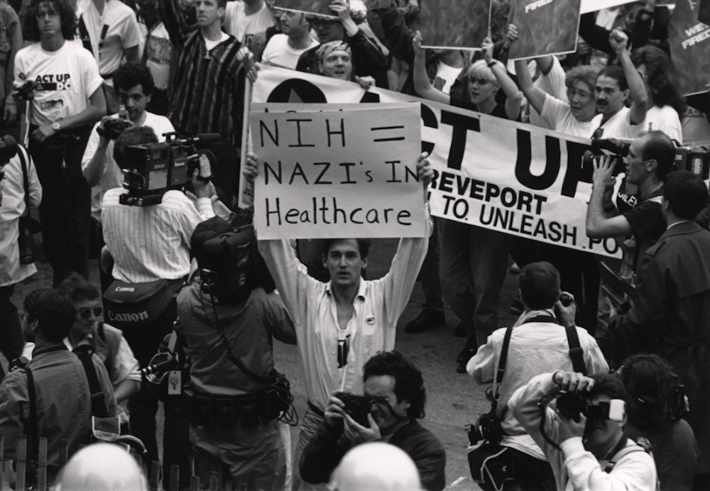
Notes:
It’s worth bearing in mind that in 1996, the HIV epidemic had been ongoing for nearly 15 years. So we are talking about an epidemic with a history.
Moreover, for the majority of this time, the question of the development of effective treatments was a highly political one. HIV was possibly the first disease where ‘Treatment Activism’ played a major role in shaping the biomedical response. We can see this in the actions of Act-UP, The Treatment Activist Group which was recently recounted in the film ‘How to Survive a Plague’.

Slide 8
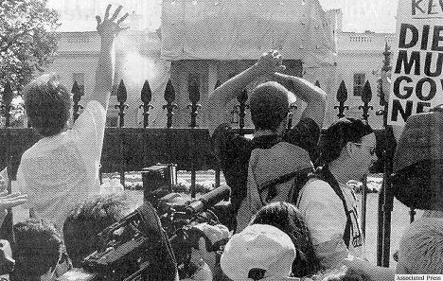
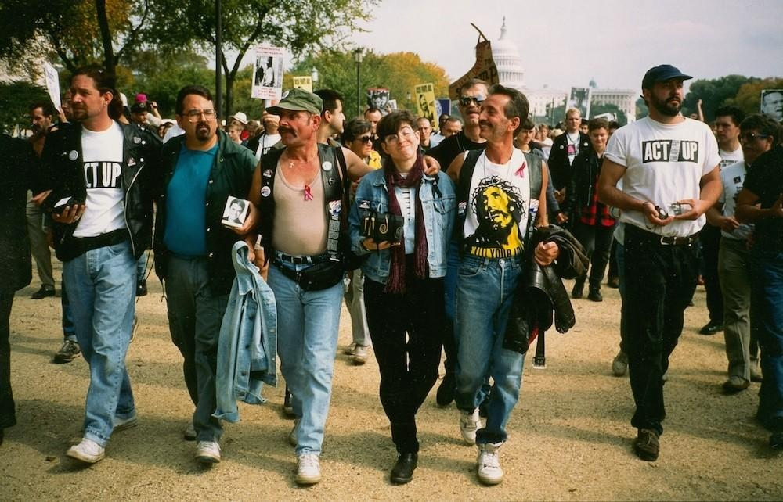
Notes:
Governments and pharmaceutical companies were infused with a profound sense of URGENCY around the development of treatments. The tactics of treatment activism meant that unlike any other disease, every day spent developing treatments and conducting trials was a day that people were dying. The high and unrelenting visibility of people who were clearly dying, at demonstrations, at conferences, at meetings with drug companies and governments was a highly effective tactic on behalf of treatment activism to generate and maintain an extreme sense of URGENCY around the development of treatments.
When the treatments appeared, in the West, this sense of urgency was maintained. Not only must the treatments be effective, but they must be seen to be effective in remarkable ways in order to ensure that governments and health systems across the West made them available as much as possible.
It is likely that this tendency gave rise to overwhelming narratives of ‘lazarus-like’ recoveries, of hospital wards closing, of people who had been near death returning to work and a happy productive life. This is not to say that the treatments were NOT effective – they were and they are. However, it is the way that they were presented as being almost miraculously effective that is of interest here.

Slide 9
Adaptive ARV technologies

Slide 10
Adaptive ARV technologies
Notes:
Our first data set is from a study about how people were responding to treatments in the UK. It was carried out in the Spring or 2007 – less than a year since the Vancouver Conference. At this time, large numbers of people with HIV in the UK were going on treatments and indeed there were many newspaper headlines of hospital wards emptying out and people going back to work.

Slide 11
Santiana
Notes:
and I’d like to talk about three people who undertook in depth interviews for this study:
Santiana was 29 years old and had migrated to the UK from Burundi. She had been diagnosed with HIV about 18 months previously. At the time of her diagnosis she had been mortally ill with tuberculosis and meningitis, for which she was still being treated.

Slide 12
Lisa
Santiana
Notes:
Lisa was 33 years old and had migrated to the UK from Uganda. She had been diagnosed 6 years previously in 1991. She had not been experienced any serious illnesses.

Slide 13
Lisa
Santiana
Robert
Notes:
Robert was 40 years old and was a UK-born gay man. He had been diagnosed ten years previously in 1986 and for most of that time had experienced little or no symptoms. However, in the previous year he had been mortally ill with tuberculosis which had been misdiagnosed and hence had remained untreated. Since then, he felt that his health was compromised.
So, two out of three had already been mortally ill or close to death, either around the time of their diagnosis or since their diagnosis. It is precisely for this group that we might assume a sense of urgency to start treatments.
However, when we go back to look at their interviews again, we find something very different. Rather than urgency, there was a profound ambivalence about the new treatments. Moreover, it was by no means taken for granted that any of them were going to start treatments. On the contrary, they described conflicted decisions and took many different factors into account when they came to these decisions.

Slide 14
Past Experiences…
Notes:
Past experiences heavily informed Both Lisa’s, Santiana’s and Robert’s perceptions of the new treatments and their decisions to start treatments.
Like many people with HIV at this time, both Robert and Santiana had recently experienced extreme illness where they had nearly died. Both had already taken long regimens of highly toxic drugs, for meningitis and for tuberculosis and were either still on these treatments or had recently finished these treatments. They needed to wait until they had ‘cleared’ these previous treatments.

Slide 15
Past experiences…
Before I was taking TB medicine, and meningitis also medicine, because the doctor said I still had bad meningitis, I can’t mix the meningitis medicine and combination [anti-retroviral treatments]. I have to wait […] because I was feared to start the combination, because the list they gave us, there was so many names of side-effects you have to get, that’s why I was scared. […] I remember it was November last year but when they checked about what I fear with meningitis, they said I have to continue first with taking the meningitis medicine. I think I finished in March this year.
Santiana
Notes:
Santiana said she feared the side effects and possible drug interactions between her meningitis treatments, her tuberculosis treatments and the new anti-retroviral treatments.
Before I was taking TB medicine, and meningitis also medicine, because the doctor said I still had bad meningitis, I can’t mix the meningitis medicine and combination [anti-retroviral treatments]. I have to wait […] because I was feared to start the combination, because the list they gave us, there was so many names of side-effects you have to get, that’s why I was scared. […] I remember it was November last year but when they checked about what I fear with meningitis, they said I have to continue first with taking the meningitis medicine. I think I finished in March this year.

Slide 16
Past experiences…
I still have one type of medicine, but I had almost nine types of TB and meningitis medicine, but now I have only one tablet because they said the meningitis, it was too bad, it was almost getting on my brain. And I started to take the combination [anti-retroviral treatments] in April.
.
Santiana
Notes:
In addition, she reported feeling overwhelmed by the sheer magnitude of drugs she was required to take.
I still have one type of medicine, but I had almost nine types of TB and meningitis medicine, but now I have only one tablet because they said the meningitis, it was too bad, it was almost getting on my brain. And I started to take the combination [anti-retroviral treatments] in April.

Slide 17
Past experiences…
When I was in hospital the doctors did mention [going on anti-retroviral treatment] […]. And I just said ‘look, you know…’ At this point I was on six months after I got out of the TB medication which involved having ten injections every day and all that. ‘Erm so there’s no way – I’m on six TB drugs or something – there’s no way I’m starting something else.
.
Robert
Notes:
Robert reported a similar experience with his TB medication:
When I was in hospital the doctors did mention [going on anti-retroviral treatment] […]. And I just said ‘look, you know…’ At this point I was on six months after I got out of the TB medication which involved having ten injections every day and all that. ‘Erm so there’s no way – I’m on six TB drugs or something – there’s no way I’m starting something else.
It’s important to remember that these were not the first anti-retroviral treatments. AZT, a partially effective HIV treatment had been available for about 10 years. All three of our participants reported their own perceptions and experiences of AZT which made them wary of the promise of new pharmaceutical treatments. In short, AZT was perceived both to be highly toxic and of limited effectiveness. These perceptions were borne out by either personal experience with AZT or the experience of friends.
Robert says:
The earliest person that I knew well who had died – well, I don’t know how long it’s been going now, but it feels like about fourteen-fifteen years, you know, right at the beginning. You know myself and several of his close friends were always convinced that it was AZT that killed him, not necessarily the drug but the dosage. He was one of the first guinea-pigs that was just full of it. And when he wasn’t on it he was fine. He looked very healthy, but when he was actually on the dosage that he was on it was not very nice to see.

Slide 18
Past experiences…
The earliest person that I knew well who had died – well, I don’t know how long it’s been going now, but it feels like about fourteen-fifteen years, you know, right at the beginning. You know myself and several of his close friends were always convinced that it was AZT that killed him, not necessarily the drug but the dosage. He was one of the first guinea-pigs that was just full of it. And when he wasn’t on it he was fine. He looked very healthy, but when he was actually on the dosage that he was on it was not very nice to see.
.
Robert
Notes:
Robert says:
The earliest person that I knew well who had died – well, I don’t know how long it’s been going now, but it feels like about fourteen-fifteen years, you know, right at the beginning. You know myself and several of his close friends were always convinced that it was AZT that killed him, not necessarily the drug but the dosage. He was one of the first guinea-pigs that was just full of it. And when he wasn’t on it he was fine. He looked very healthy, but when he was actually on the dosage that he was on it was not very nice to see.
These embodied experiences also took on a strong social and political dimension. Treatments were a major topic of interest and controversy amongst people with HIV at this point. Both Lisa and Santiana talked about listening to other women in their social support groups who warned against AZT and pharmaceutical treatments generally.
Lisa says:
I used to come [to an HIV support group] a lot and I met a few women who had been diagnosed for quite a longer time and they were all like, ‘Don’t take drugs. No AZT’. And they were all showing me their nails and their nails were all dark and their skins and they were all like, ‘AZT - once you start taking AZT you are going to die’. So for a long time I resisted medication.

Slide 19
Past experiences…
I used to come [to an HIV support group] a lot and I met a few women who had been diagnosed for quite a longer time and they were all like, ‘Don’t take drugs. No AZT’. And they were all showing me their nails and their nails were all dark and their skins and they were all like, ‘AZT - once you start taking AZT you are going to die’. So for a long time I resisted medication.
.
Lisa
Notes:
Lisa says:
I used to come [to an HIV support group] a lot and I met a few women who had been diagnosed for quite a longer time and they were all like, ‘Don’t take drugs. No AZT’. And they were all showing me their nails and their nails were all dark and their skins and they were all like, ‘AZT - once you start taking AZT you are going to die’. So for a long time I resisted medication.

Slide 20
Past experiences…
…[A]s I say a lot of my friends, one of my friends then was very active in a group with a chap called Positively Healthy, and they were all the kind of real radicals of the time. And I was very fortunate to know him, because he was saying ‘don’t touch these drugs, don’t do this, do that’, you know? And he steered me right in a lot of, I think, and I always maintain throughout the years that a lot of it was due to advice, sensible advice…
Robert
Notes:
Robert had experiences of more directly political responses around treatments.
…[A]s I say a lot of my friends, one of my friends then was very active in a group with a chap called Positively Healthy, and they were all the kind of real radicals of the time. And I was very fortunate to know him, because he was saying ‘don’t touch these drugs, don’t do this, do that’, you know? And he steered me right in a lot of, I think, and I always maintain throughout the years that a lot of it was due to advice, sensible advice…
What these data tell us about is the often forgotten embodied, social and political dimensions that pharmaceutical treatments had. The new anti-retroviral treatments were not seen as a dramatic departure necessarily, but rather were closely related to or continued out of earlier and far more toxic treatments around which controversy and dissent flowed.
Moreover, as we will see later, people with HIV often maintained more or less contested or antagonistic relationships with their clinical providers – all three participants talked about varying degrees of pressure from their doctors to start treatments which they sometimes chose to resist. For example, Robert was a patient at a large London HIV clinic whilst he remained asymptomatic. He feels that his repeated rejection of AZT and other treatments may have influenced the degree of interest his clinicians had in him and how he was treated. The interviewer asks:

Slide 21
Past experiences…
Did you feel under pressure to take drugs?
Yes, very much so at times at the [clinic name], and with the same doctor. And I was always very aware [that] if you are reluctant to go on [treatments], and you stand your ground, you’re somehow kind of not treated. I don’t mean treated as well but, you know, they’re not as keen to kind of help you.
Not as attentive?
Not as attentive, that’s the word, yeah. You can’t say that they kind of discriminate against you, but there is certainly something there, or certainly was a few years ago. I don’t know how it is at the minute.
Robert
Notes:
The interviewer asks:
Did you feel under pressure to take drugs?
Yes, very much so at times at the [clinic name], and with the same doctor. And I was always very aware [that] if you are reluctant to go on [treatments], and you stand your ground, you’re somehow kind of not treated. I don’t mean treated as well but, you know, they’re not as keen to kind of help you.
Not as attentive?
Not as attentive, that’s the word, yeah. You can’t say that they kind of discriminate against you, but there is certainly something there, or certainly was a few years ago. I don’t know how it is at the minute.

Slide 22
The process of deciding
Notes:
So, we can see that for Robert, Lisa and Santiana, whether or not they went on treatments was by no means a ‘foregone conclusion’, nor was there necessarily any sense of major urgency around them commencing treatments, despite their symptoms and illnesses. However, at the time of interview, all three had recently commenced combination treatments. We now turn to look at how they came to the decision to start treatments.
What is immediately noteworthy is that Robert, Lisa and Santiana all engaged with and processed significant information in coming to their decision.

Slide 23
The process of deciding..
I’d been on the mailing list for about ten years for [a project] in San Francisco and Gay Men’s Health Crisis in New York […] And Body Positive. But of course the American ones were that bit more specialised.
So you’d been actually reading about these drugs for quite a long time?
Yes, since the start. Of course reading them differently now. At one point ‘oh, these don’t apply to me’, so it was kind of skimming through it, and then when reality dawned you think ‘well, better find out’.
Robert
Notes:
Robert was the most active in this sense. He talks about following treatment advances, even when he was symptomatic and had no intention of going on treatments. He discusses the characteristics of various information sources.
I’d been on the mailing list for about ten years for [a project] in San Francisco and Gay Men’s Health Crisis in New York […] And Body Positive. But of course the American ones were that bit more specialised.
So you’d been actually reading about these drugs for quite a long time?
Yes, since the start. Of course reading them differently now. At one point ‘oh, these don’t apply to me’, so it was kind of skimming through it, and then when reality dawned you think ‘well, better find out’.

Slide 24
The process of deciding…
But then coming to May my T cells, CD4 count started falling really rapidly and by the time. From about January it feel from about 70 / 30 / 20 / 10. And it was the turning point and by that time I was quite aware of what would happen if I lost all my CD4 count, I could get CMV and I think that was the most terrifying thing. I didn’t want to go blind and what I thought was that I would rather keep the few I have rather than losing more of them. And really trying to learn more about treatment and attending seminars, workshops, reading, asking my doctor lots of questions.
.
Lisa
Notes:
Lisa too talks about finding information as she became more concerned about her health and future.
But then coming to May my T cells, CD4 count started falling really rapidly and by the time. From about January it feel from about 70 / 30 / 20 / 10. And it was the turning point and by that time I was quite aware of what would happen if I lost all my CD4 count, I could get CMV and I think that was the most terrifying thing. I didn’t want to go blind and what I thought was that I would rather keep the few I have rather than losing more of them. And really trying to learn more about treatment and attending seminars, workshops, reading, asking my doctor lots of questions.
What is also striking looking back at the transcripts is the extent to which the decision to commence treatment is a profoundly social one. All three participants talked about reliance on their friends and other social networks to help them in coming to their decision.

Slide 25
The process of deciding…
The main thing is nobody can do it. You have to decide yourself, it’s your decision. No-one can ma
The main thing is nobody can do it. You have to decide yourself, it’s your decision. No-one can make the decision for you. When I ask some of the people, some in the group, some now are not yet started, and there had known a long time, but some they have not yet started. But some have started. or you. When I ask some of the people, some in the group, some now are not yet started, and there had kno Santiana
Notes:
Santiana wanted to talk things through with other people who had started on treatments or indeed who had decided not to commence treatments.
The main thing is nobody can do it. You have to decide yourself, it’s your decision. No-one can make the decision for you. When I ask some of the people, some in the group, some now are not yet started, and there had known a long time, but some they have not yet started. But some have started.

Slide 26
The process of deciding…
. I think also I did discuss my going on treatment a lot with my partner, my sister, brother in-law […] And I had a sister in America and she kept on sending me all this information and kept on calling and saying, ‘You have to go on this treatment. I’ve seen it doing wonders for a number of people here’. And my mother also, she didn’t know whatever it was but she just said that she’d heard the treatment is doing wonders and I should go on it.
Lisa
Notes:
Two of Lisa’s siblings were medical doctors and she talked about taking their advice.
I think also I did discuss my going on treatment a lot with my partner, my sister, brother in-law […] And I had a sister in America and she kept on sending me all this information and kept on calling and saying, ‘You have to go on this treatment. I’ve seen it doing wonders for a number of people here’. And my mother also, she didn’t know whatever it was but she just said that she’d heard the treatment is doing wonders and I should go on it.

Slide 27
The process of deciding…
One time I went to my doctor with about five friends and we all sat round and we were asking him so many questions and we did that about three times.
Lisa
Notes:
However, Lisa also relied on the support of other women with HIV. She remembers clearly how she and four other women sat quizzing their HIV physician for some time before they made a decision to go on treatments.
One time I went to my doctor with about five friends and we all sat round and we were asking him so many questions and we did that about three times.

Slide 28
The process of deciding..
Saquinavir, because [doctor] then felt I could switch across to indinavir if it didn’t work. Erm friends of mine who live in New York are very friendly with the doctor who is very high up in HIV medicine there, and they had gone to an open forum in New York on my behalf, to find out all about the protease inhibitors. And they talked to this specialist, and he said ‘what’s your friend’s situation over ten years’, and they said ‘well he’s never taken anything’. So this doctor said ‘well I would think he’s got a good chance of it working, but I would recommend he goes for indinavir’, which out of all the reading I had done was the one in some way that appealed. Robert
Notes:
Like Lisa, Robert relied on the active intervention of friends to determine what particular pharmaceutical treatment he should commence with. His UK doctor felt he should start on Saquinavir, which at the time was perceived to be a somewhat less aggressive treatment than its correlate Indinavir, perhaps switching over to Indinivar in time. Robert felt he should start with Indinavir.
Saquinavir, because she then felt I could switch across to indinavir if it didn’t work. Erm friends of mine who live in New York are very friendly with the doctor who is very high up in HIV medicine there, and they had gone to an open forum in New York on my behalf, to find out all about the protease inhibitors. And they talked to this specialist, and he said ‘what’s your friend’s situation over ten years’, and they said ‘well he’s never taken anything’. So this doctor said ‘well I would think he’s got a good chance of it working, but I would recommend he goes for indinavir’, which out of all the reading I had done was the one in some way that appealed.

Slide 29
Being on treatments
Notes:
We know now that the treatments developed in 1996 and those that follows, when used effectively can work for the longer term – that they should deliver what has been called a normal life expectancy. However, we forget that we did not know this in 1996. We did not know how long the treatments would work, how much time would they buy? How many years would they add to life?
Moreover the side affects were unknown – and to some extent, remain unknown. What would these highly toxic drugs do to your body in the medium and the long-term? For us now, these are important questions, but for Santiana, Robert and Lisa, these were embodied questions. Their bodies were the site where these uncertainty resided. So, the experience of taking these early treatments is important to examine.
What is remarkable for me, when I look back at these interviews is the sheer complexity of the treatments. Today, HIV treatments are 1 or two pills per day with few immediately experienced side-effects. However, treatment decisions in 1997 were hugely complex.
Once our participants had made the decision to start treatments, they then found themselves in this complex world of deciding which combination of treatments are likely to work and how we can tell?
The question of ‘running out of options’ was a major concern at this time. The problem was that everytime you switched treatments, you risked developing a resistence to the drug you had just stopped taking, therefore rendering it useless if you wanted to go back on that drug. So there was a definite incentive to stay on treatments even if they were not yielding immediate results to make sure that they were the wrong drugs before you switched to another drug.
In the following series of quotes we follow Robert through the experience of switching from one treatment to another treatment combination. He had been on treatments for about 3 months when his doctor tells him that they want to switch his treatment to another combination.

Slide 30
Being on treatments
…it was never explained very well – [I asked my doctor] ‘is this like a headache where if you took an aspirin you’re expecting it to work immediately, or is it a thing that will work over a period of time’. [Doctor replied] ‘Oh well we expect good results fairly rapidly’ and I said ‘well, you’re not getting that with me’, ‘I know’ was the reply, [¼]and I said ‘why is it you’re reluctant to hang on, […]- you know, because there aren’t that many other options really’.
.
Robert
Notes:
…it was never explained very well – [I asked my doctor] ‘is this like a headache where if you took an aspirin you’re expecting it to work immediately, or is it a thing that will work over a period of time’. [Doctor replied] ‘Oh well we expect good results fairly rapidly’ and I said ‘well, you’re not getting that with me’, ‘I know’ was the reply, [¼]and I said ‘why is it you’re reluctant to hang on, […]- you know, because there aren’t that many other options really’.
We see that Robert does not know what to expect from the treatments at the beginning – how were they supposed to work? How quickly? What does ‘working’ even mean. What he does know is that he doesn’t have many options so he is very wary of his doctors when they say they want to switch combinations [don’t forget, Robert is quite suspicious of drugs and doctors given his experience with AZT].
Robert talks about the diagnostic tests that measure his viral load and CD4 counts. These were the tests that his doctors used to consider whether and how well his treatments were working.

Slide 31
Being on treatments
…And then [my viral load count] had dropped significantly. I had a feeling that it might have, because I was feeling well, so I was kind of: ‘yeah it is getting a bit better’, and I was right. Er and they [doctors] were thrilled because [viral load] had gone from something like¼ it lingered around 150,000 – 170,000 and they eventually got it down by July to thirty-five. They were pleased with that.
.
Robert
Notes:
…And then [my viral load count] had dropped significantly. I had a feeling that it might have, because I was feeling well, so I was kind of: ‘yeah it is getting a bit better’, and I was right. Er and they [doctors] were thrilled because [viral load] had gone from something like¼ it lingered around 150,000 – 170,000 and they eventually got it down by July to thirty-five. They were pleased with that.
However for his doctors, this was ‘not good enough’.

Slide 32
Being on treatments
What I hadn’t realised until I was at the 175 mark, whenever that was, maybe May, was that it had been six and half million […] So of course when he said that to me, I said ‘well, it was six and half million – I think something’s working here’. ‘Yes, but not enough’ [laughs]. I said ‘well I’m quite happy, thanks very much’.
Robert
Notes:
What I hadn’t realised until I was at the 175 mark, whenever that was, maybe May, was that it had been six and half million […] So of course when he said that to me, I said ‘well, it was six and half million – I think something’s working here’. ‘Yes, but not enough’ [laughs]. I said ‘well I’m quite happy, thanks very much’.
Robert struggled with his doctors about his regimen. He says he was ‘terrified’ when his doctor told him he would have to switch.

Slide 33
Being on treatments
Terrified. I said to the doctor last week when I finally came off the current [treatment combination]. Because he just said to me ‘I’m taking you off them’, not that he was terrified at having to tell anybody that the drugs they’re on for the illness aren’t working – it’s a major thing for a doctor to have to tell you, knowing that there aren’t really that many other options. So he did it very kind of briskly, you know, said ‘that’s it’, and I said ‘oh dear, that’s not very good’ and tried to laugh it off, and I said ‘you know it took me ten years to pluck up the courage to put an AZT tablet in my mouth’, I said ‘it’s taken ten months for it to prove not to work, and ten minutes just to throw it in the bin. Robert
Notes:
Terrified. I said to the doctor last week when I finally came off the current [treatment combination]. Βecause he just said to me ‘I’m taking you off them’, not that he was terrified at having to tell anybody that the drugs they’re on for the illness aren’t working – it’s a major thing for a doctor to have to tell you, knowing that there aren’t really that many other options. So he did it very kind of briskly, you know, said ‘that’s it’, and I said ‘oh dear, that’s not very good’ and tried to laugh it off, and I said ‘you know it took me ten years to pluck up the courage to put an AZT tablet in my mouth’, I said ‘it’s taken ten months for it to prove not to work, and ten minutes just to throw it in the bin.
The other major concern was the toxicity of the drugs and side effects. The major question here was whether taking the treatments, with all the difficulties it involved was worth it. We need to remember that no-one knew how long the treatments would work for or what they might do to one’s body. Santiana assumes that the times the drugs would work is limited.

Slide 34
Being on treatments
The main thing is nobody can do it. You have to decide yourself, it’s your decision. No-one can ma
I thought that [new treatments] would give me three to five years and maybe after three to five years something, anything could come up whilst I was failing on the drugs because of resistance. I think that was the main thing. The fears around what if I fail on the drugs or what if they fail me, what happens after five years. But I thought if I didn’t go on combination therapy I’d have something within two years or one. So going on the therapy was a stronger factor for me. I was scared and still am because I don’t know whether… If I develop resistance to all the drugs will I go back to what I was or worse than what I was? And I asked my doctor that and he doesn’t know, he told me he doesn’t know. We just have to wait and see.. started, and there had kno Santiana
Notes:
I thought that [new treatments] would give me three to five years and maybe after three to five years something, anything could come up whilst I was failing on the drugs because of resistance. I think that was the main thing. The fears around what if I fail on the drugs or what if they fail me, what happens after five years. But I thought if I didn’t go on combination therapy I’d have something within two years or one. So going on the therapy was a stronger factor for me. I was scared and still am because I don’t know whether… If I develop resistance to all the drugs will I go back to what I was or worse than what I was? And I asked my doctor that and he doesn’t know, he told me he doesn’t know. We just have to wait and see..
These concerns were aggrevated when all three of our participants started experiencing disturbing side effects. Santiana developed ‘crix belly’ – this is due to a redistribution of fat around the body cause by one drug. This led to very disturbing and unsightly bodily modifications such as a large belly, a wasted face and withering of the arms and legs. Moreover, both Santiana and Lisa told of how their entire body shape changed: they suddenly gained excess weight.
Lisa talks about how gaining 2 stone (13 kilos) has changed her sense of self. Before starting treatments, she was reasonably healthy and she had a full-time job and career which she enjoyed greatly. However all this has changed since she started taking the treatments. She says:

Slide 35
Being on treatments
I’ve gained two stone [13 kilos]. I was 11 stone and as soon as I started the medication within one and a half months I’d moved up to 13 stone. So it’s uncomfortable and I used to be really. I used to walk long distances and I’d have no problem. When I have a lot of problem, my thighs especially, my knees, even when I’m seated. […]. I used to wonder why people complain when they’re getting up or women saying, ‘Oh I can’t walk that far’, but that’s happening to me now and I just feel very tired.
Lisa
Notes:
I’ve gained two stone [13 kilos]. I was 11 stone and as soon as I started the medication within one and a half months I’d moved up to 13 stone. So it’s uncomfortable and I used to be really. I used to walk long distances and I’d have no problem. When I have a lot of problem, my thighs especially, my knees, even when I’m seated. […]. I used to wonder why people complain when they’re getting up or women saying, ‘Oh I can’t walk that far’, but that’s happening to me now and I just feel very tired.
She reports a sense of the medications turning her into a different woman; a woman who is overweight and tired and ill.

Slide 36
Being on treatments
There are times I even stop and shut my eyes for about a minute on the road because I’m tired. I get into a bus and I just want to sleep. I come into work and at times I go into the children’s room to just sleep for about 15 minutes. I’m out a lot sick because I’m tired. It’s mainly fatigue, I’m just tired and that’s why I went to see my doctor yesterday to really find out if these drugs were working.
Lisa
Notes:
There are times I even stop and shut my eyes for about a minute on the road because I’m tired. I get into a bus and I just want to sleep. I come into work and at times I go into the children’s room to just sleep for about 15 minutes. I’m out a lot sick because I’m tired. It’s mainly fatigue, I’m just tired and that’s why I went to see my doctor yesterday to really find out if these drugs were working.
At this time, there was a lot of attention being paid the fact that people with HIV on treatments could go back to work. However, Lisa was already in work in a full time job. She feels that being on treatments may lead to her actually stopping working.

Slide 37
Being on treatments
And I can’t believe all this hype around back to work. Back to work - oh my God - I’m on therapy and I’m working and I feel like leaving work. I really feel like I’m just… I don’t know what would happen to me if I left work but at the moment that’s what I want to do. I want to leave work.
Lisa
Notes:
And I can’t believe all this hype around back to work. Back to work - oh my God - I’m on therapy and I’m working and I feel like leaving work. I really feel like I’m just… I don’t know what would happen to me if I left work but at the moment that’s what I want to do. I want to leave work.
This leads us to question the whole notion of treatments ‘working’ . For our three participants, the embodied experience of taking the treatments was very different to the ‘lazarus-like’ accounts we hear elsewhere.

Slide 38
Conclusions
Notes:
I want to emphasise that we are not expressing any doubts that pharmaceutical HIV treatments work. We are describing a time twenty years when these treatments were indeed highly experimental and their future effectiveness was unknown. HIV pharmaceuticals have transformed out of all recognition the experience of living with the virus.
What we are also saying is that, going back and looking at the data collected at the time shows us that the dominant narrative we hold now about HIV treatments was not reflected in the experiences of the people who took them at the time. The introduction of treatments is largely understood now as a transformative moment in time when the HIV epidemic changed forever. What we see, in the contrary is that change was much slower to come. Indeed, the people taking these treatments did not see themselves as necessarily being ‘rescued from death’ or ‘cured’, but rather they were being asked to embark on an unknown journey the outcome of which was far from sure. They often experienced this as a dangerous and frightening journey.
Our analysis of later datasets shows that the process of bringing into being ‘a life with HIV’ was a slow, difficult and halting one. Crucially, it depended on the willingness of people like Santiana, Lisa and Robert to engage with the treatments and continue to engage with them. And in doing so, these were the people who, bit by bit and year by year crafted the experience of life with HIV we know now – the normal life with HIV, with few side effects and a long and healthy life.
Our analysis of other data sets also tells us that certain forms of pre-existing embodied knowledge, ways of living with and accommodations to HIV surround this notion of ‘scientific breakthrough’. The implementation depends on a number of engagements with pharmaceuticals and bio-medicine which are more or less risky and more or less enterprising. Through these engagements, people find ways of living with the treatments, of taking small measured steps based on what the treatments will or will not allow them to do. These engagements bring into being narratives of surviving and thriving.

Slide 39
Emerging findings 1
Going on the treatments is a decision which is:
social.
about complex knowledge.
about a collective political identity or position,
profoundly embodied
Pharmaceutical and health have pre-existing social and embodied meanings too.
Pharmaceutical treatments were considered risky and politically imbued.
Notes:
Going on the treatments is a decision. It is not taken lightly.
This decision is profoundly social – influenced by interaction with other PWHIV and observation of the experiences of others – as well as substantial knowledge acquisition and negotiation with doctors. For one person it was about a collective political identity or position, for another it was through newly found peer support networks.
It is also profoundly embodied – it depends on one’s sense of self as ill – as having been near death.
Pharmaceutical and health have pre-existing social and embodied meanings too. Pharmaceutical treatments were considered risky and politically imbued.

Slide 40
Emerging findings 2
Pharmaceutical and health have pre-existing social and embodied meanings too.
Pharmaceutical treatments were considered risky and politically imbued.
Concepts of ‘the drugs are working’ and ‘being healthy’ or ‘being better’ are complex and contested.
Significant ambivalence to taking treatments, changing regimens or remaining on treatments.
Notes:
Concepts of ‘the drugs are working’ and ‘being healthy’ or ‘being better’ are complex and contested. There are a lot of very problematic meanings and experiences attached to these concepts and how they are described and experienced.
Possibly connected to this, there is a significant ambivalence to taking treatments, changing regimens or remaining on treatments. These are not merely ‘compliance issues’ but go much deeper.
The question of ‘whether it will work’ or ‘what are the chances of it working’ are ever present. – scepticism -

Slide 41
Reflections
Coming at it ‘cold’ (forgetting)
Emotional responses (remembering)
Surprised by sheer volume of relevant material
Keeping track of ‘silences’ / absences
Notes:
Reading back through these data has elicited so many complex thoughts and feelings in those of us who have been working with it. For me, returning to the words of the men and women who have taken part in research over the past 20 years tells me just how quickly what we ‘know’ at a particular moment can fade from memory.
- Irwin and Winter point out, however that our distance from even our own work can contribute to the development of new lines of enquiry
Going through this historic data and working and talking with colleagues about it has elicited recollections of people with HIV that we personally knew and loved who did not start the treatments in 1996. Some had died already, and some had concerns about this new treatment, having tried so many failed treatments before. So some people were (and continue to be) sceptical because they were tired of having their hopes raised and then dashed.
Keeping track of the ‘absences’ in terms of who did not take part in these studies, who did not speak of ARVs when they did take part. That has proven a challenge, and is something we are still working on – as it is crucial to the development of our next project.

Slide 42
Co-investigators
Co-Investigators:
Adam Bourne, LaTrobe University
Virginia Berridge, LSHTM
Paul Flowers, Glasgow Caledonian University
Corinne Squire, University of East London
Peter Weatherburn, Sigma Research @ LSHTM
Ingrid Young, University of Edinburgh
Funded by a Wellcome Trust Seed Award
Notes:
Catherine and I have been working in collaboration with a network of qualitative HIV social scientists, all acknowledged in this slide.

