Slide 1
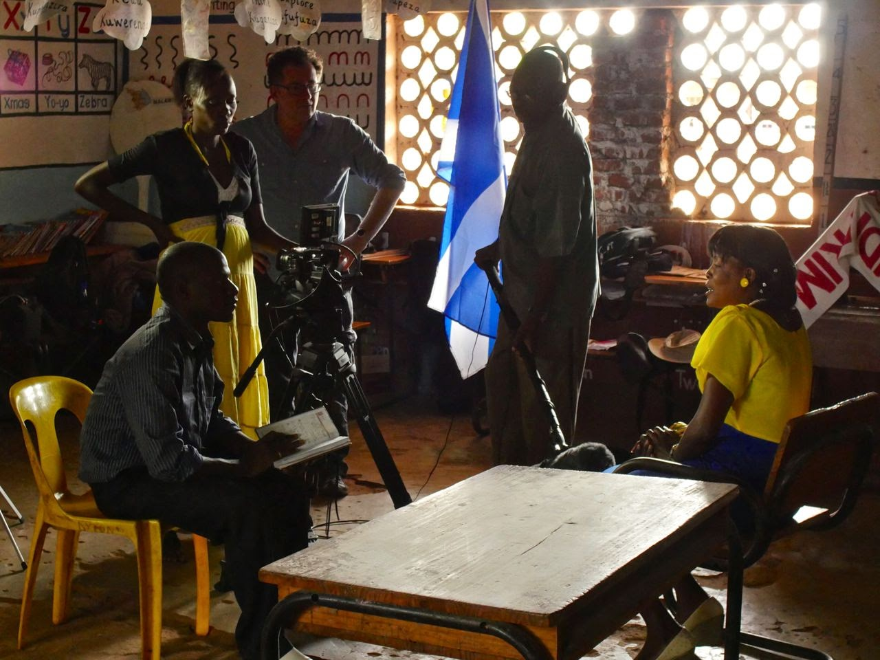
Introduction to participatory research
Wednesday 5th June 2019
Stuart Hall Building Conference Room
Dr Alison Buckler
alison.buckler@open.ac.uk

Slide 2
Order of session
Introduction
World Café Exercise
Participatory research data-generation activity
Presentations and discussion
Wrap-up
(optional screening of participatory video film)

Slide 3
World Café Exercise
Developing a collaboratively generated understanding of participatory research

Slide 4
World Café Exercise
Developing a collaboratively generated understanding of participatory research
Prompt questions:
What kinds of skills and commitments do participatory researchers need?
What activities / strategies could you use to engage participants / generate data? (think about before, during and after the research. What logistical / social / cultural factors need to be considered?)
What are the potential advantages and risks of participatory research? (for both researchers and communities)

Slide 5
Engaging with participatory approaches
Top tips for being a PhD student at the Open University
Group 1: Photo voice
Group 2: Podcast
Group 3: Tactile modelling
You have 15 minutes to complete your task. Each group should prepare a 2-minute presentation in response to the prompt. More details on your task-sheet.

Slide 6
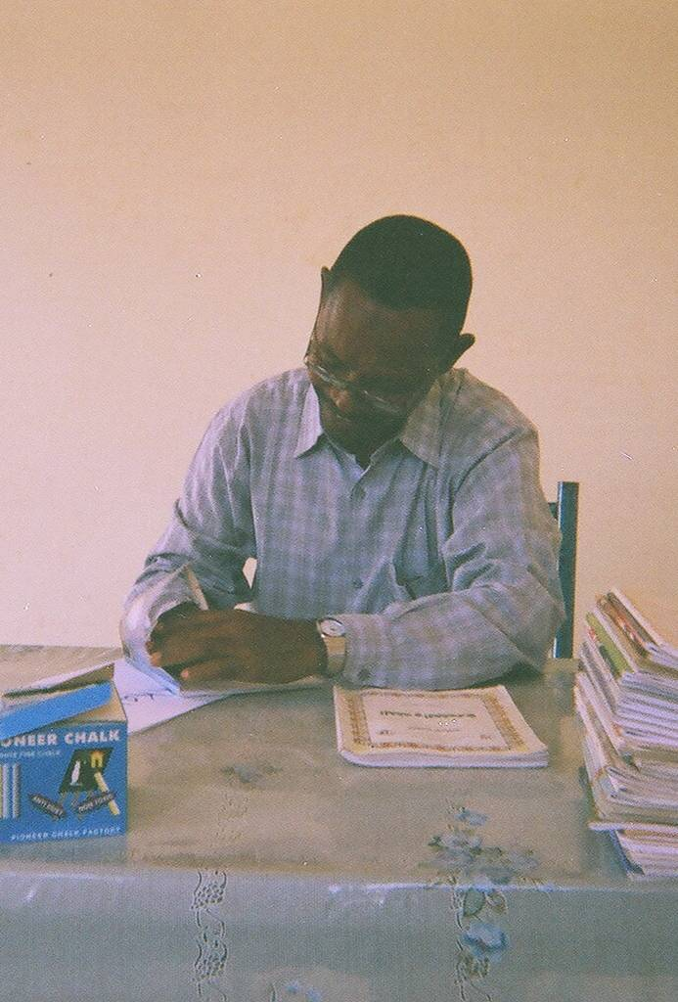
Further reading / useful links
Participatory research methods: a methodological approach in motion (comprehensive introductory text)
http://www.qualitative-research.net/index.php/fqs/article/view/1801/3335
A Ladder of Citizen Participation (influential text: Arnstein 1969) http://www.tandfonline.com.libezproxy.open.ac.uk/doi/pdf/10.1080/01944366908977225?needAccess=true
Quick reference guide for hosting World Cafes http://www.theworldcafe.com/wp-content/uploads/2015/07/Cafe-To-Go-Revised.pdf
Photovoice (helpful, brief overview) http://www.flinders.edu.au/sabs/fippm-c4c-files/All%20about%20Photovoice.pdf
Insight Share (participatory video methods and resources) http://insightshare.org/
‘A different kind of teacher’ (blog from an OU-funded participatory video project in Malawi) http://differentkindofteacher.blogspot.co.uk/
Defining participatory video in practice (High et al 2012) http://oro.open.ac.uk/33069/1/Running_head.pdf
Participation: the new tyranny? (well-cited critique of participatory practice: Cooke and Korthari 2001) https://www.amazon.com/Participation-New-Tyranny-Bill-Cooke/dp/1856497941
Indigenous voices and the making of the post-2015 development agenda: the recurring tyranny of participation (contemporary application of Cooke and Kothari’s critique to global development planning: Enns, Bersaglio and Kepe 2014) http://www.tandfonline.com.libezproxy.open.ac.uk/doi/full/10.1080/01436597.2014.893482?scroll=top&needAccess=true

Slide 7
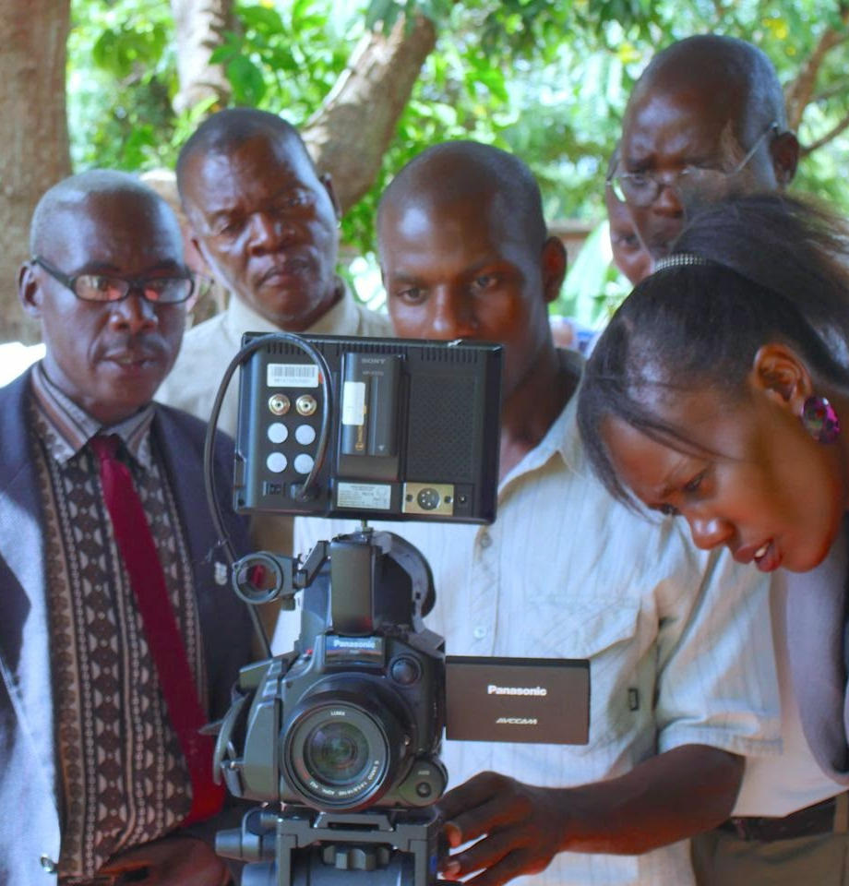
Optional extra tasks
If you are interested in exploring some of the ideas further, write a short, reflective response (around 250 words) to one (or more if you like!) of the following questions. If you would like to share and discuss these with me I would be more than happy (send to alison.buckler@open.ac.uk) but this too is entirely optional.
Do you think participatory approaches might be helpful in your research? How could you use them?
Read about the ‘tyranny of participation’ (see further reading). How are the risks particularly relevant for PhD students?
Do you speak (or will you be researching in) another language? What word/s would you use to describe / depict participatory research?
Compare Arnstein’s (1969) ladder of participation with Pretty’s (1995) typology of participation. Which do you think is most relevant to your work?
Think about the suggestion of the Sudanese professor to use a professional (Sudanese) photographer to take the photos instead of the teachers. Would that have been more or less aligned with the principles of participatory research than the actual research plan?

